Slide 1
Relationship As a Spiritual Practice Chelsea Wakefield, PhD, LCSW
“Your task is not to seek for love
but to find the barriers
you have built against it.”
Rumi

Slide 2
Our work as Spiritual Guides/Companions
Spacious, transformative field
Settle down and look inward:
Resolve spiritual conflicts
Develop/deepen spiritual practices
Discern important questions
Heal
Open potentials

Slide 3
Jungian work is inherently spiritual
Establish a connection to and conversation and ultimately an alignment with the resonance of the deep Self (soul).
When connection to the Self is severed, a person will begin to suffer in ways they cannot name and medication won’t touch this suffering.
When we make life decisions from our Ego Identity, obscuring the guidance from the Self, we always end up in trouble.

Slide 4
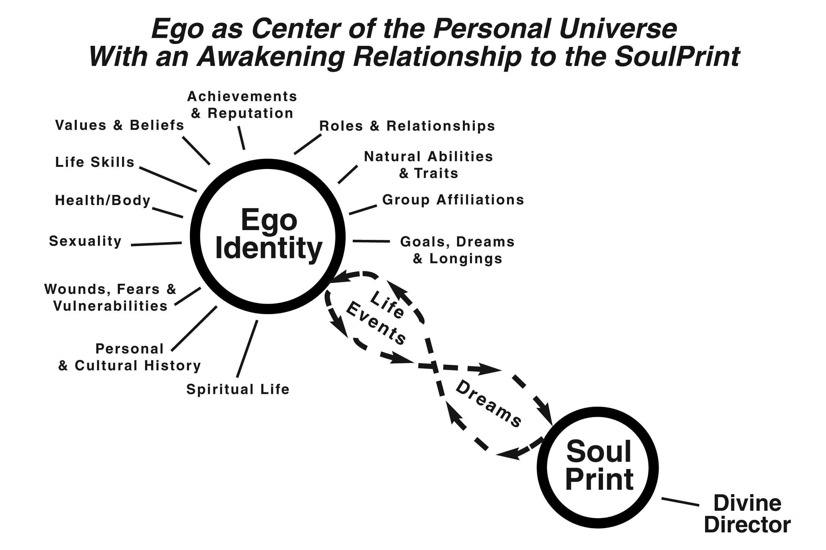

Slide 5
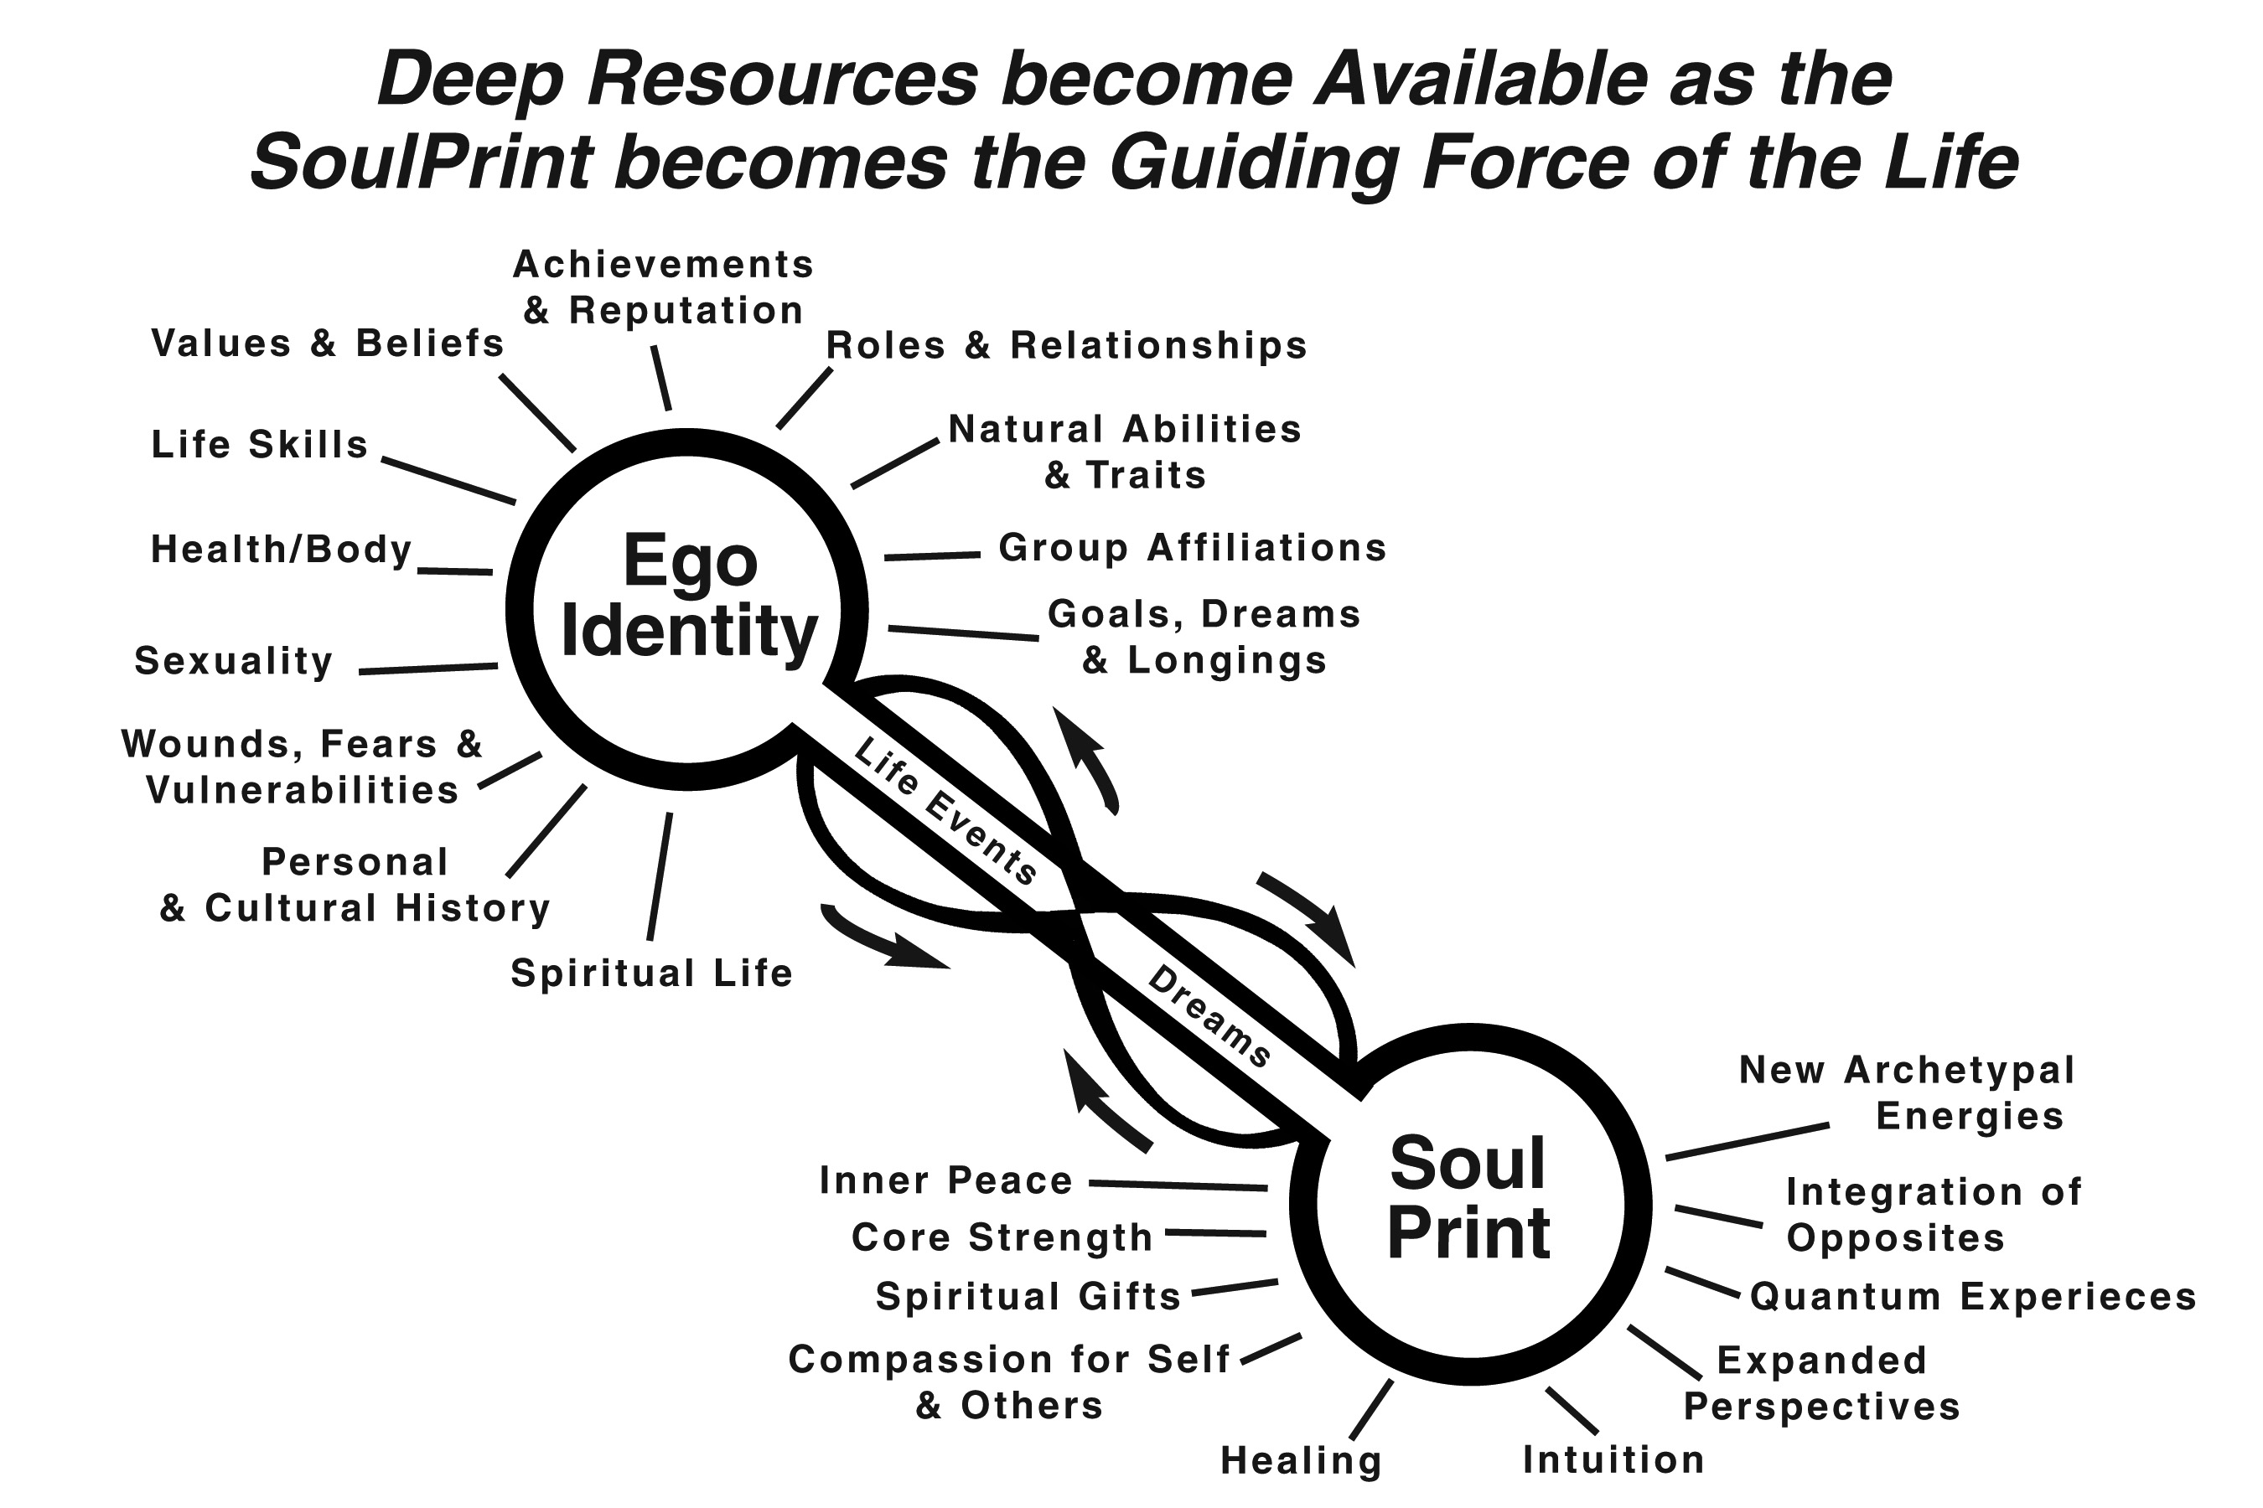

Slide 6
Phases along
The Relationship Roadmap
Enchantment
Disenchantment
The Promised Land of a Mutually Co-Created, Conscious Relationship
Personal and Interpersonal Work Begin
Struggle and Anguish… Wandering in the Wilderness
Chelsea Wakefield, PhD © 2015-2018

Slide 7
We are attracted to:
People who fit into our completion story
We have an Overstory (conscious) and an Understory (unconscious)
All of this gets projected out onto the idealized “Other”
How another person makes us feel – discovering new aspects of self
Many of the qualities that drew us initially begin to irritate us.

Slide 9
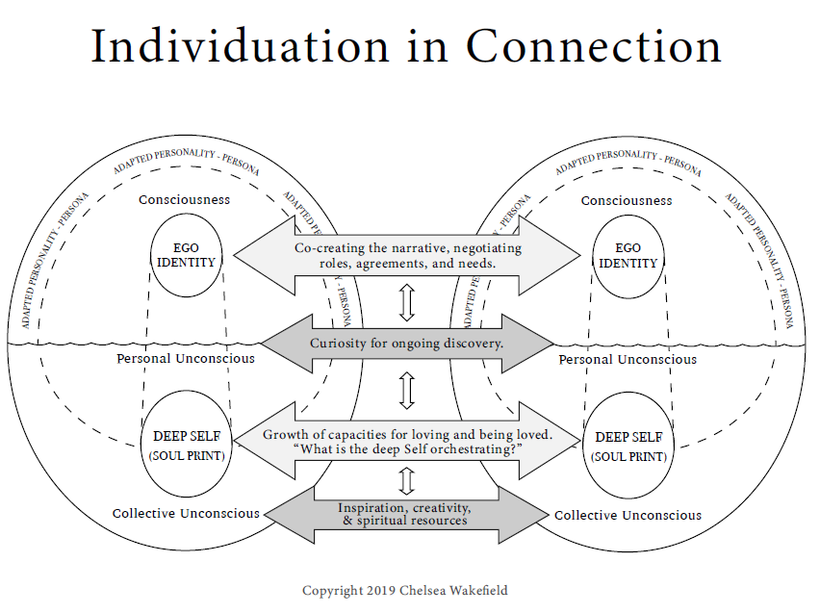

Slide 10
3 Levels of Relationship
Need Meeting
Role Mates
Soul Mates…. Developing a Soulful Relationship

Slide 11
Martin Buber
“All journeys have secret destinations of which the traveler is unaware.”
I-Thou (soul to soul) versus I-It (transactional). All of life is meeting.
“When two people relate to each other authentically and humanly, God is the electricity that surges between them.”

Slide 12
Most couples get stuck in power struggles
“Where love rules, there is no will to power, where power dominates, there love is lacking. The one is the shadow of the other.”
Carl Jung

Slide 13
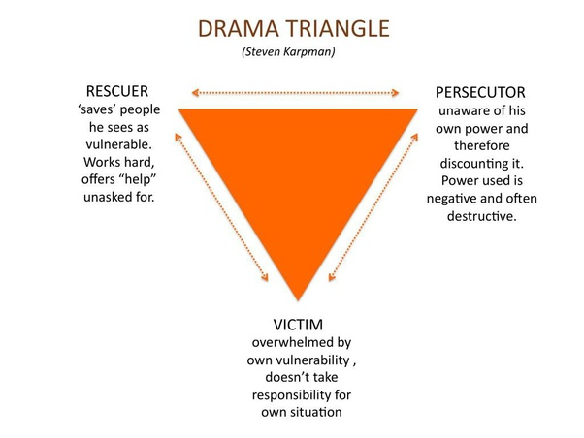

Slide 15
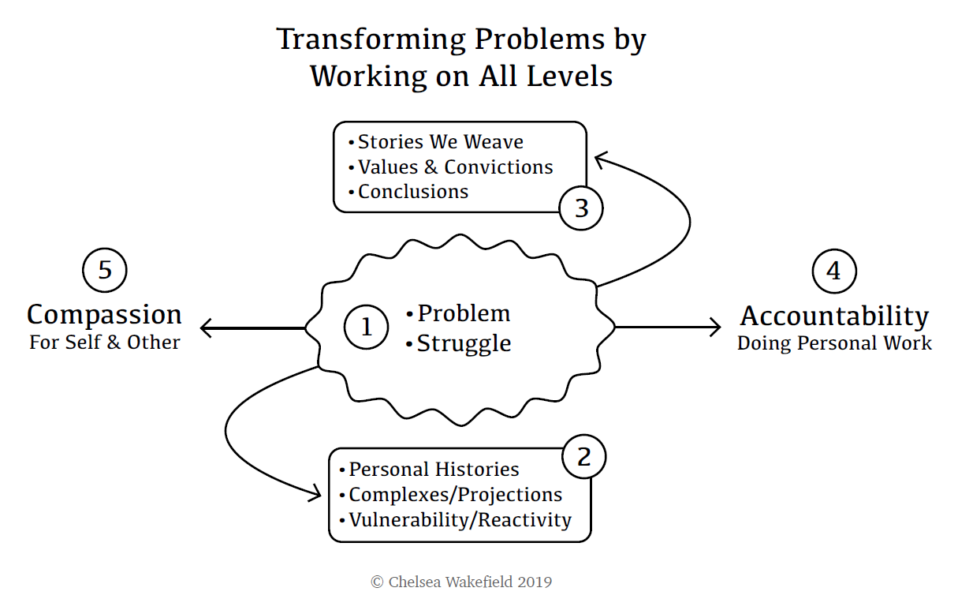

Slide 16
Relationship as Anthropology Study
EMPHASIS ON PERSPECTIVE TAKING
Suspending a confident, premature “foreclosure” on who the other is.
Others have a separate subjective world from mine. My worldview is not the one view to rule them all.
Curiosity - how do things work over in your world
Crossing the bridge to the other world, leaving your baggage behind
What am I making your behaviors and customs mean
What do they mean over there? What is the history behind them?
If I had your history, how might I see things?.... What might I be projecting if I were you?

Slide 17
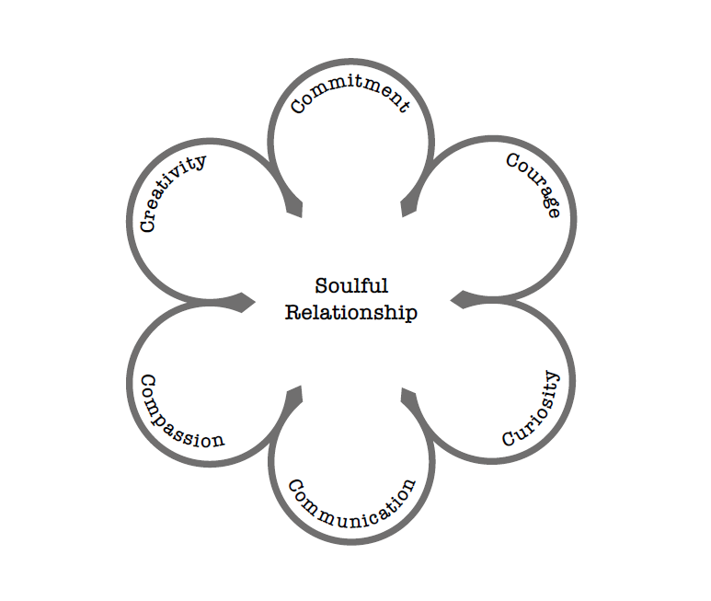
The SIX LOVE CAPACITIES
From The Labyrinth of Love

Slide 18
AFFAIRS and EROTIC ATTRACTIONS
You carry some quality I am hungry for.
You make me feel ALIVE.
I like who I become when I’m with you – you open new possibilities in me
“You SEE me and I like what you see!”– the power of reflected self

Slide 19
When the Ego’s needs are not met- it goes on a scavenger hunt…
Shadow outcroppings of unworked childhood material
When the Soul’s needs are not met- it goes looking for water
The Shadow co-opts all of this for its agenda.
Most affairs begin when the Ego and the Shadow pair up

Slide 20
Where is the Spiritual Guidance Work?
What is the Ego seeking here?
What unmet needs are trying to be met – Historical? Present time?
What is being protected or defended against?
What needs to be relinquished?
What is seeking to be healed?
~~~~~~~~~~~~~~~~~~~~~~
What is coming alive?
What is the soul seeking?

Slide 21
Spiritual Bypass?
Examples:
Rules and edicts
Forbidden emotions
Spiritual people don’t have errant sexual feelings, fantasies, or desires
Spiritual Guidance question - If spiritual bypass is occurring, what is being bypassed?

Slide 22
LOST by David Wagoner
In the midst of a relationship struggle remember these words
Stand still. The trees ahead and bushes beside you Are not lost. Wherever you are is called Here, And you must treat it as a powerful stranger, Must ask permission to know it and be known.

Slide 23
The Vulnerable Children Inside - Our Inner Orphans

Slide 24
Who would you be without that story? Byron Katie
QUESTIONS TO HOLD OR OPEN
What if you changed the lens thru which you are looking?
What are your fears around letting it go?
What would you have to face without that story?
What is the “old identity” you are clinging to?
Can you make space for a new identity?
Are you open to the Self (Soulprint) and spirit’s leading/synchronicities/dream-states/ learning to tune into intuitions versus complexes

Slide 26
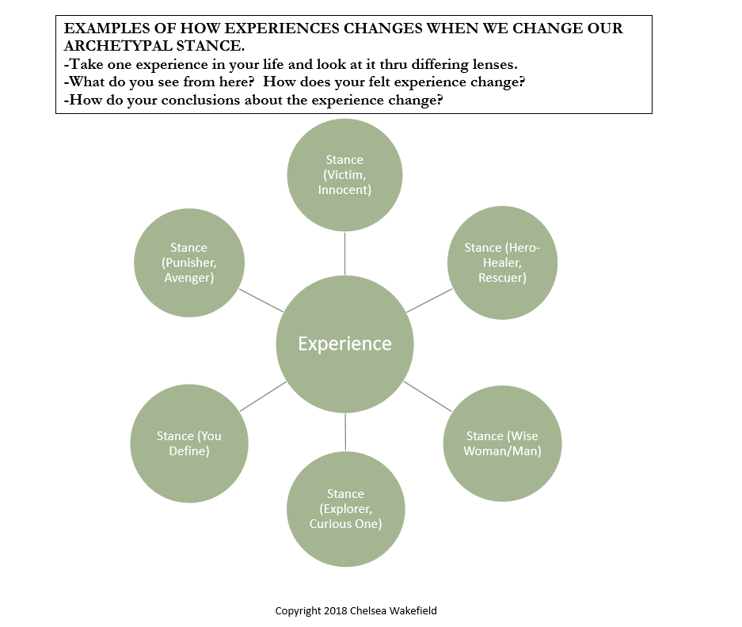

Slide 27
SUFFERING IS NOT THE PROBLEM POINTLESS SUFFERING IS WHAT WE WANT TO AVOID
Buddhist teaching about the two poles of suffering – Clinging/Craving; Avoidance/Aversion
WHAT IS THE EGO DEMANDING?
What “eyes” am I looking thru?
What adaptive stories and childhood complexes am I in the grip of?
What am I overidentified with? What role, quality, archetype?
What am I clinging to that needs to be relinquished?
What am I resisting, denying, disowning, refusing to see?
If I looked out of different “eyes” what would I see?
How would this change the story I am weaving and my reaction to that story?

Slide 28
Integration work
Being With and Staying With what has been disowned – images, memories
Compassion for the self you are and once were
Visualization work
Healing presence
Elemental forces that cleanse
Symbolic work/Rituals
Creative Arts
Dreamwork

Slide 29
