Slide 1
“Walking Each Other Home” Companioning those in the dying season of life
Aditi Sethi, MD
The Haden Institute
Spiritual Direction Training Course
January 2024

Slide 2
Goals And Objectives
Discuss various aspects of the Dying Experience
Discuss the realities of Death and Dying in America
Discuss various aspects of Hospice and Palliative Medicine
Discuss Role of Spiritual Companion

Slide 3

My journey with end-of-life care

Slide 4


Slide 5
“No one here gets out alive.”- Jim Morrison
Reflection on Death
Everyone’s vision is unique and different
Everyone’s idea of a “good death” is different
As companions we CAN honor the wishes of those dying
A little knowledge and planning can go a long way
Conversations with loved ones about end-of-life wishes increase the chances that your wishes will be honored

Slide 6
Preparing for a Thoughtful Death
Meta-systematic review of the conditions for a “good death” found 11 conditions:
Relief from physical pain and other physical symptoms
Effective communication and relationship with health-care providers
The performance of cultural, religious, or other spiritual rituals
Relief from emotional distress or other forms of psychological suffering
Autonomy with regards to treatment-related decision-making
Dying in the preferred place
Life not being prolonged unnecessarily
Awareness of the deep significance of what is happening
Emotional support from family and friends
Not being a burden on anyone
Right to terminate one's life
Zaman M, Mohapatra A, Espinal-Arango S, Jadad A What would it take to die well? A systematic review of systematic reviews on the conditions for a good death.Lancet Healthy Longevity. 2021; 2: e593-e600

Slide 7
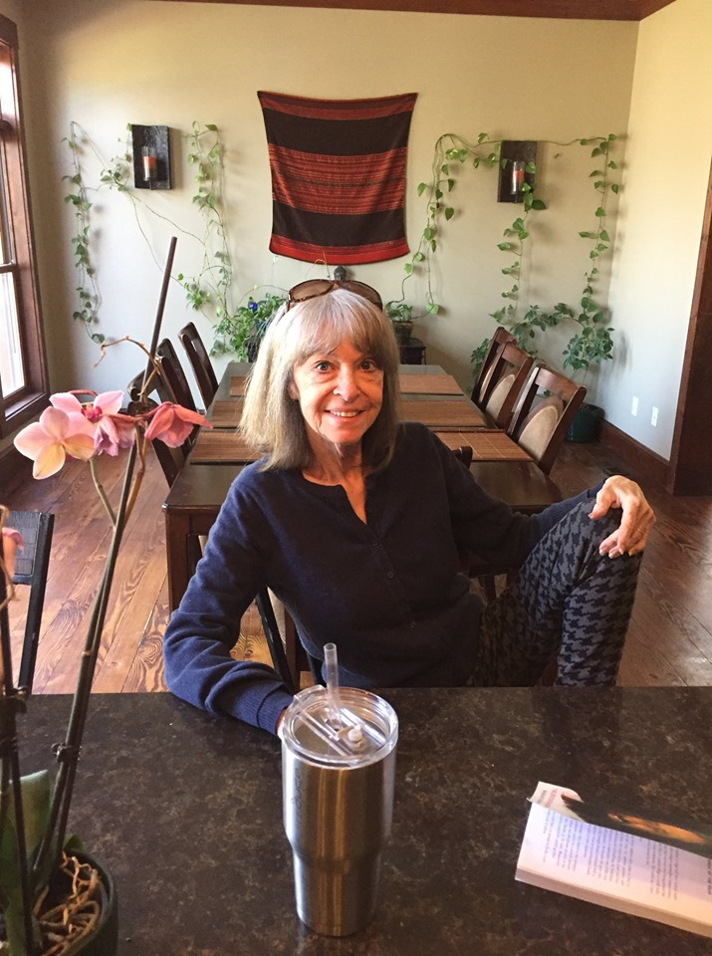
Paula Brown 1947-2019

Slide 8
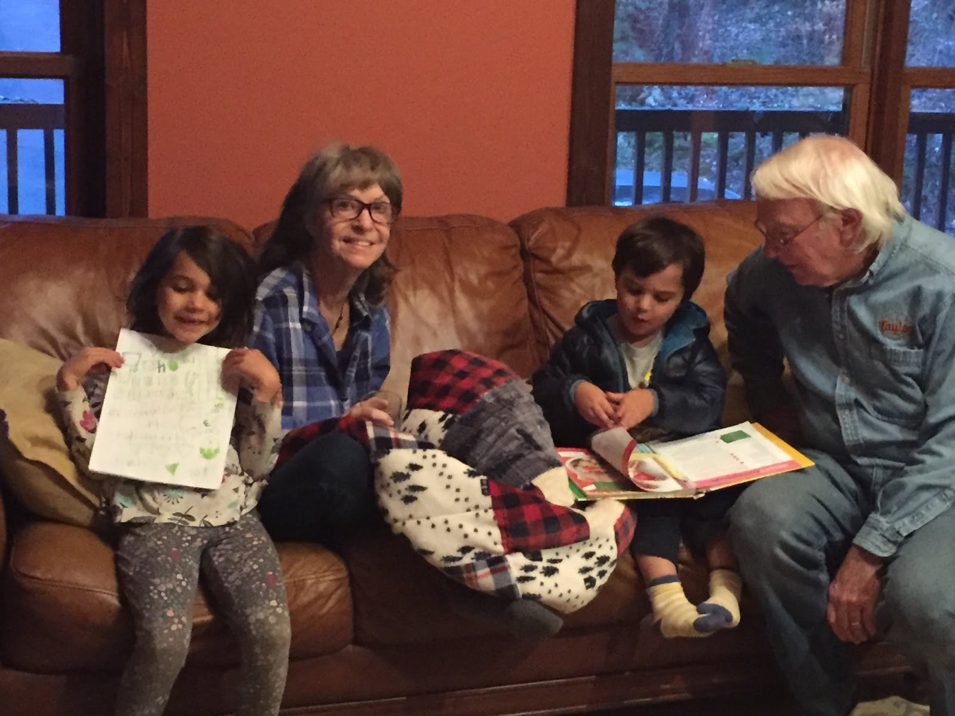

Slide 9
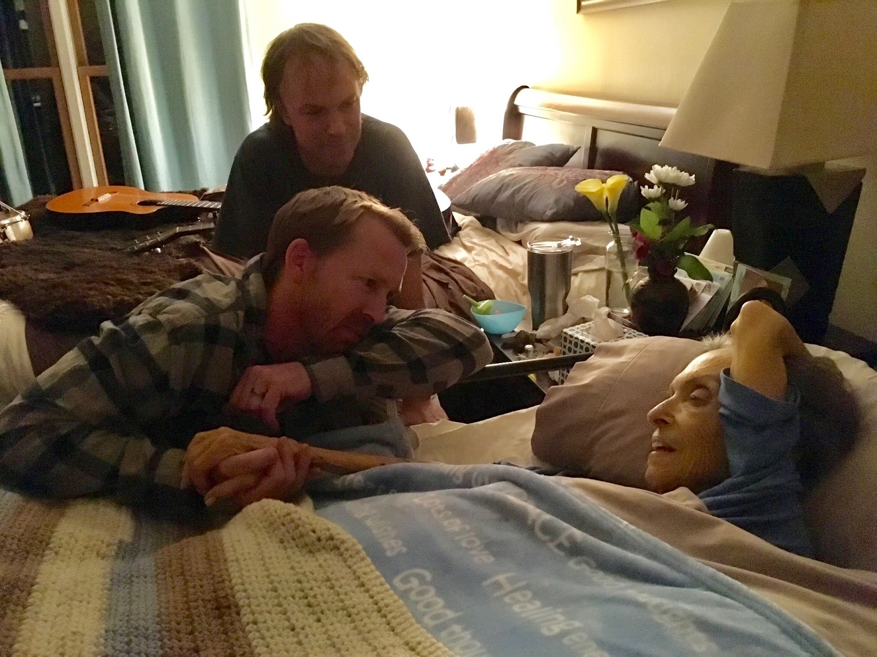

Slide 10
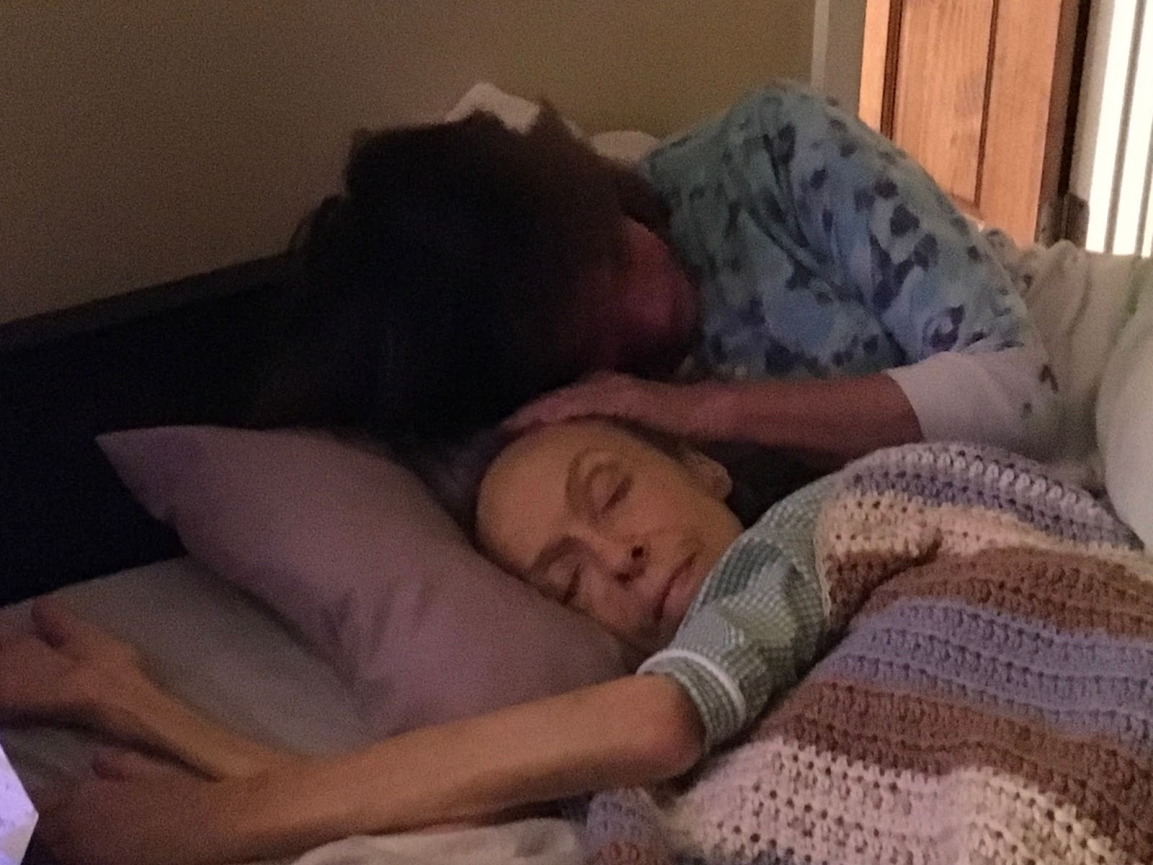

Slide 11
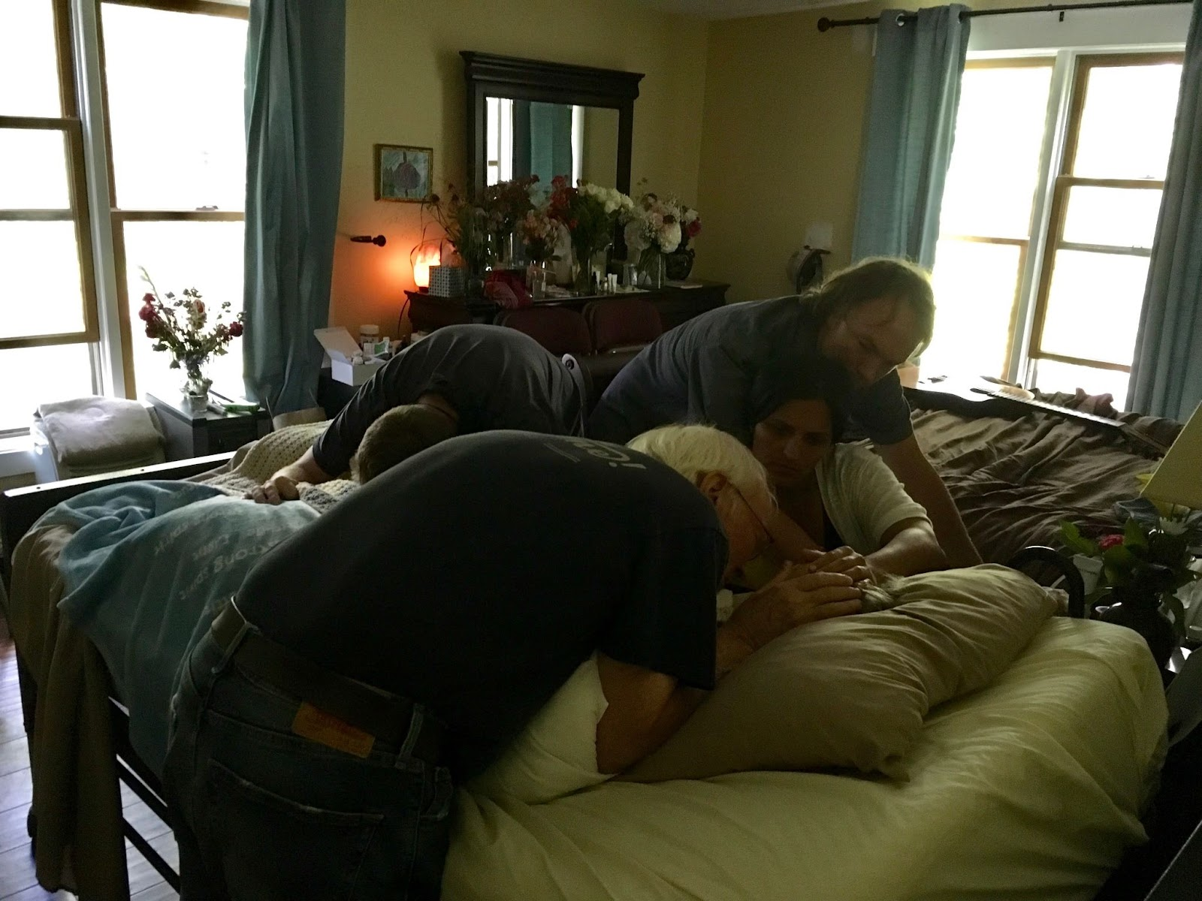

Slide 12
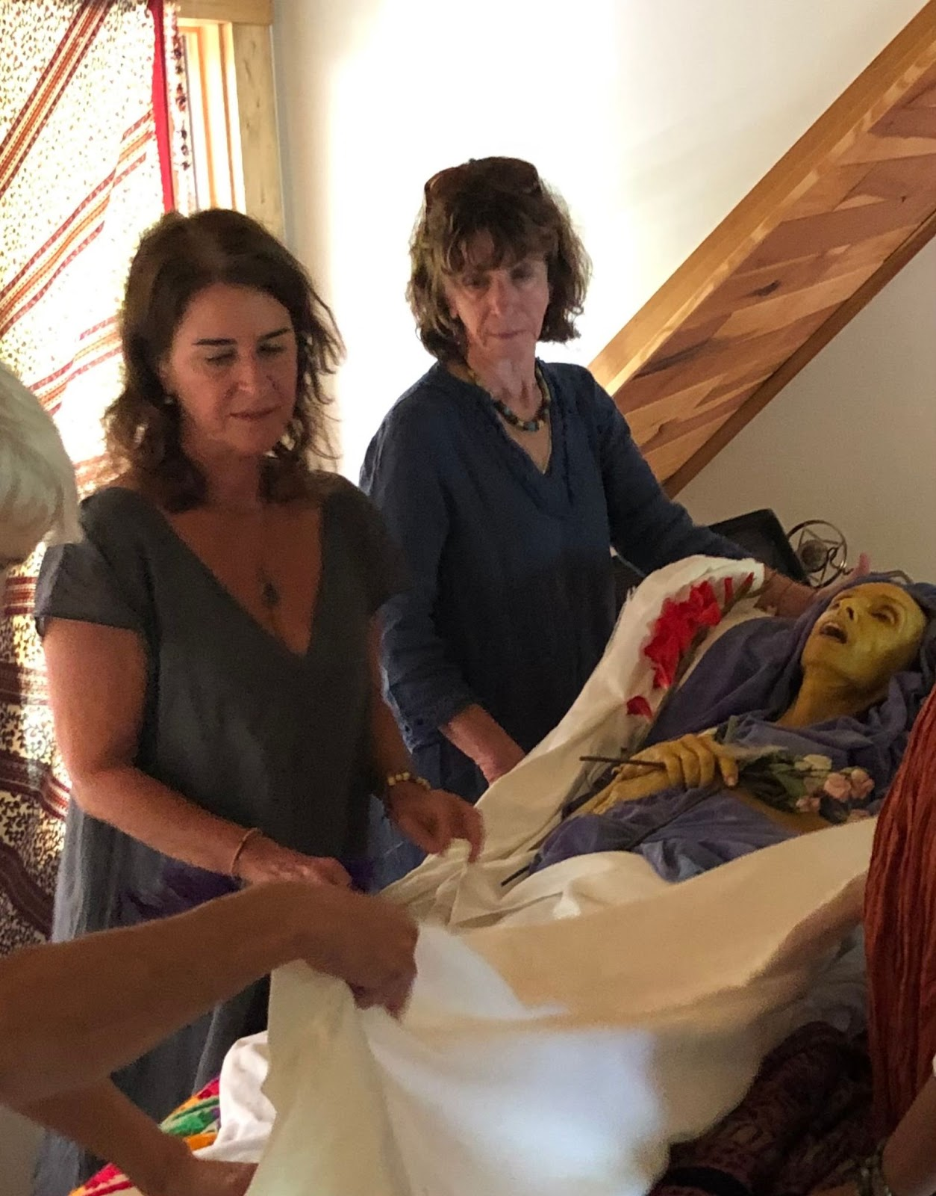

Slide 13
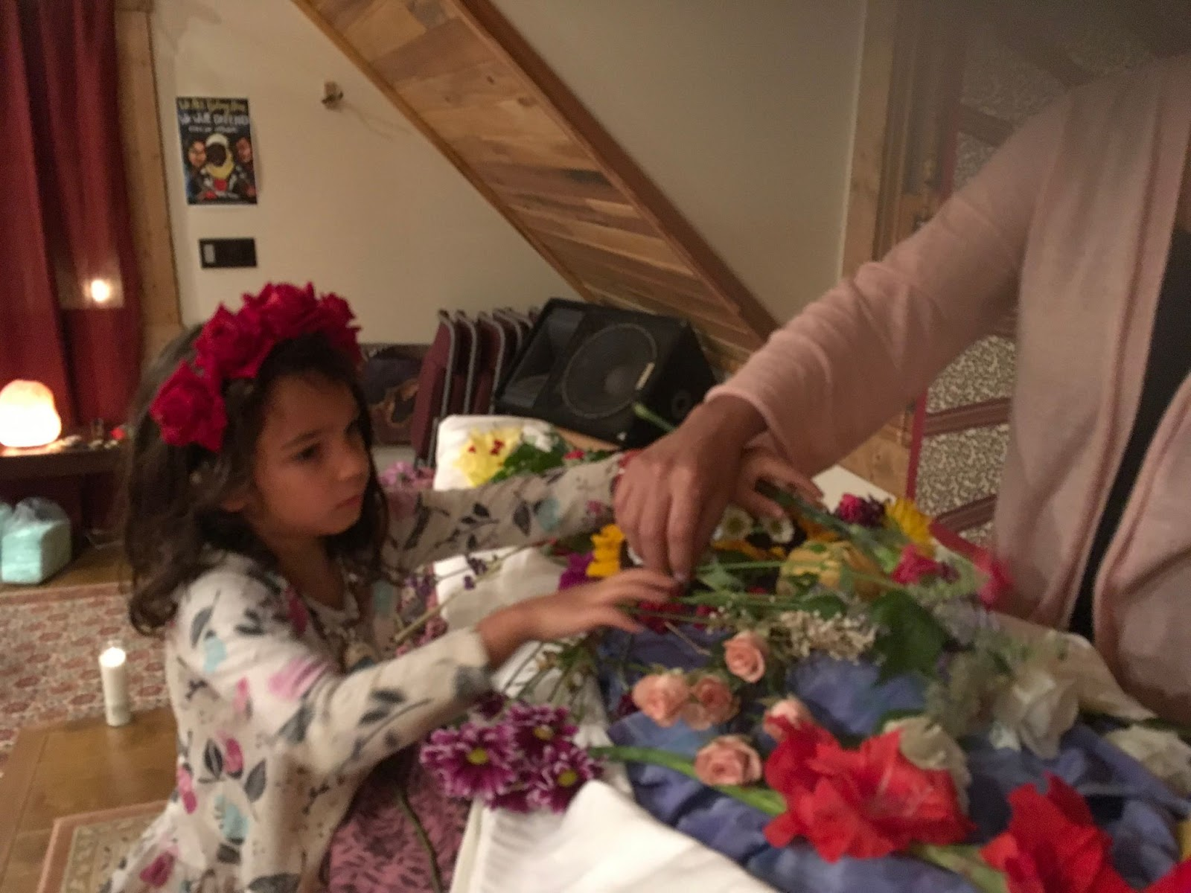

Slide 14
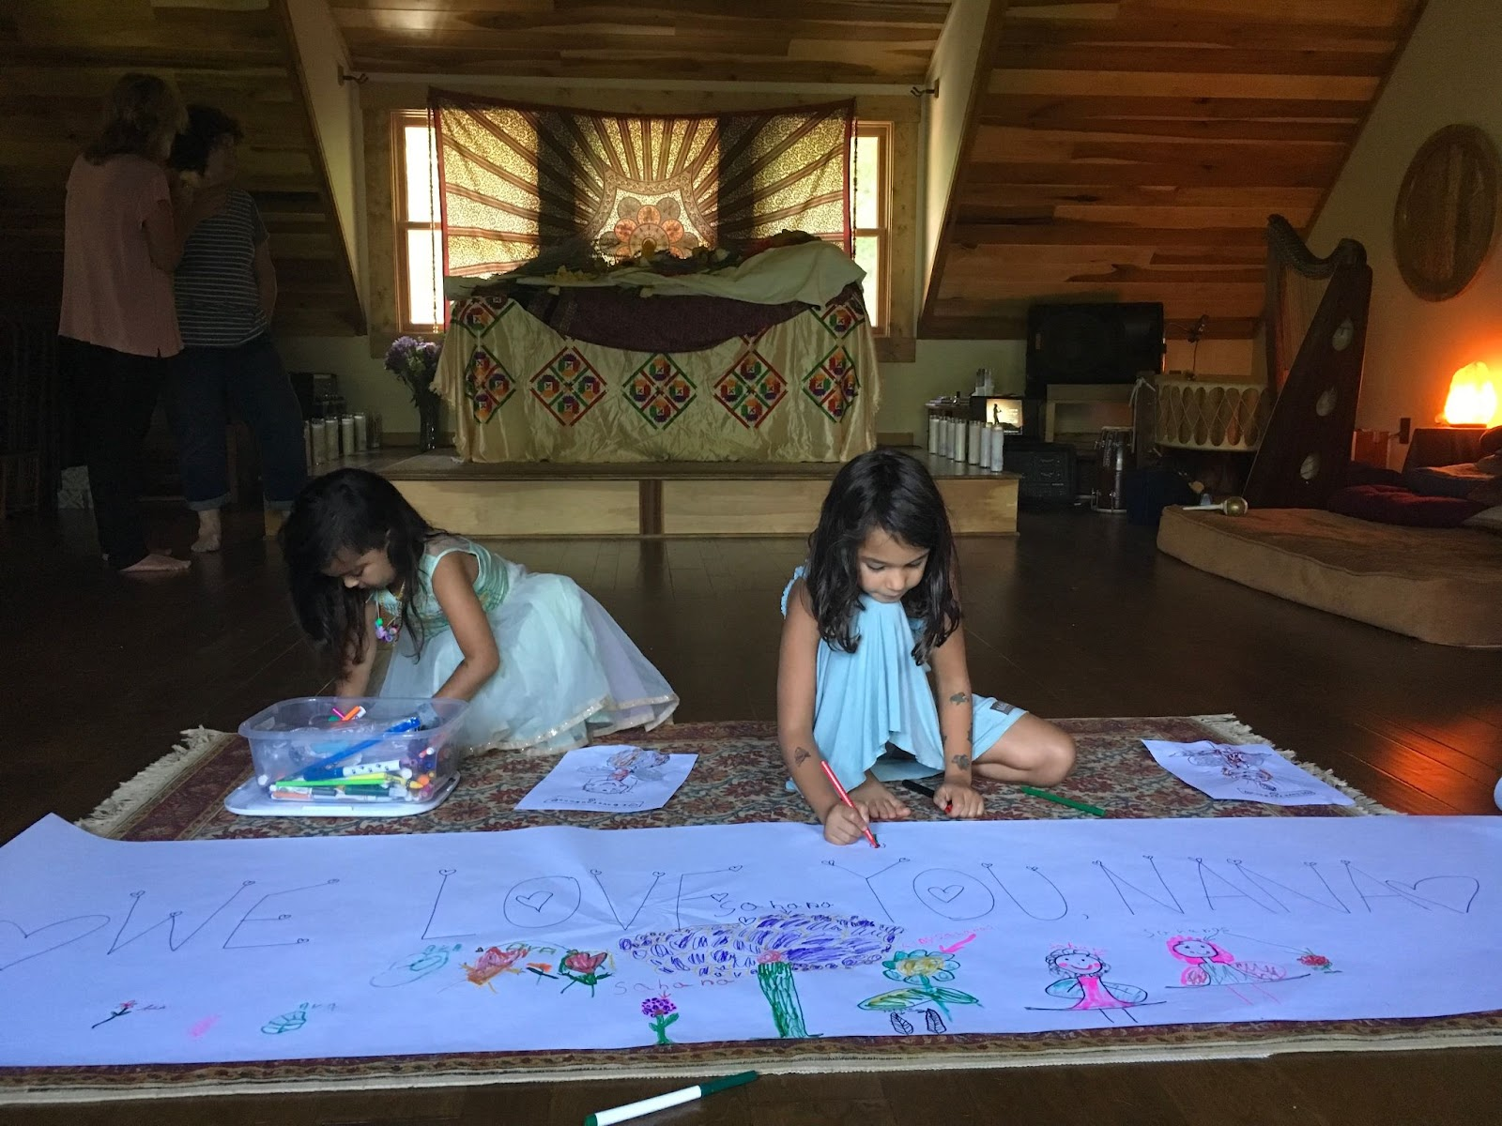

Slide 15
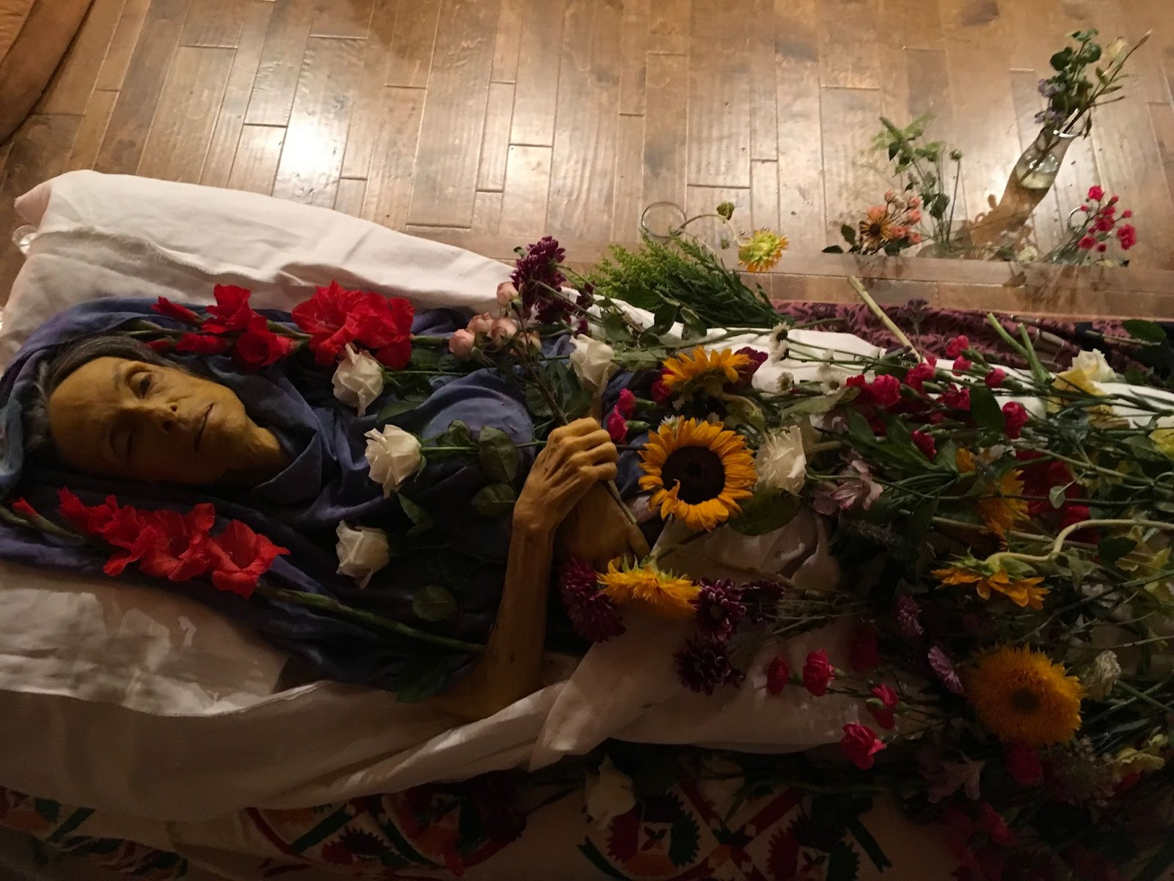

Slide 16
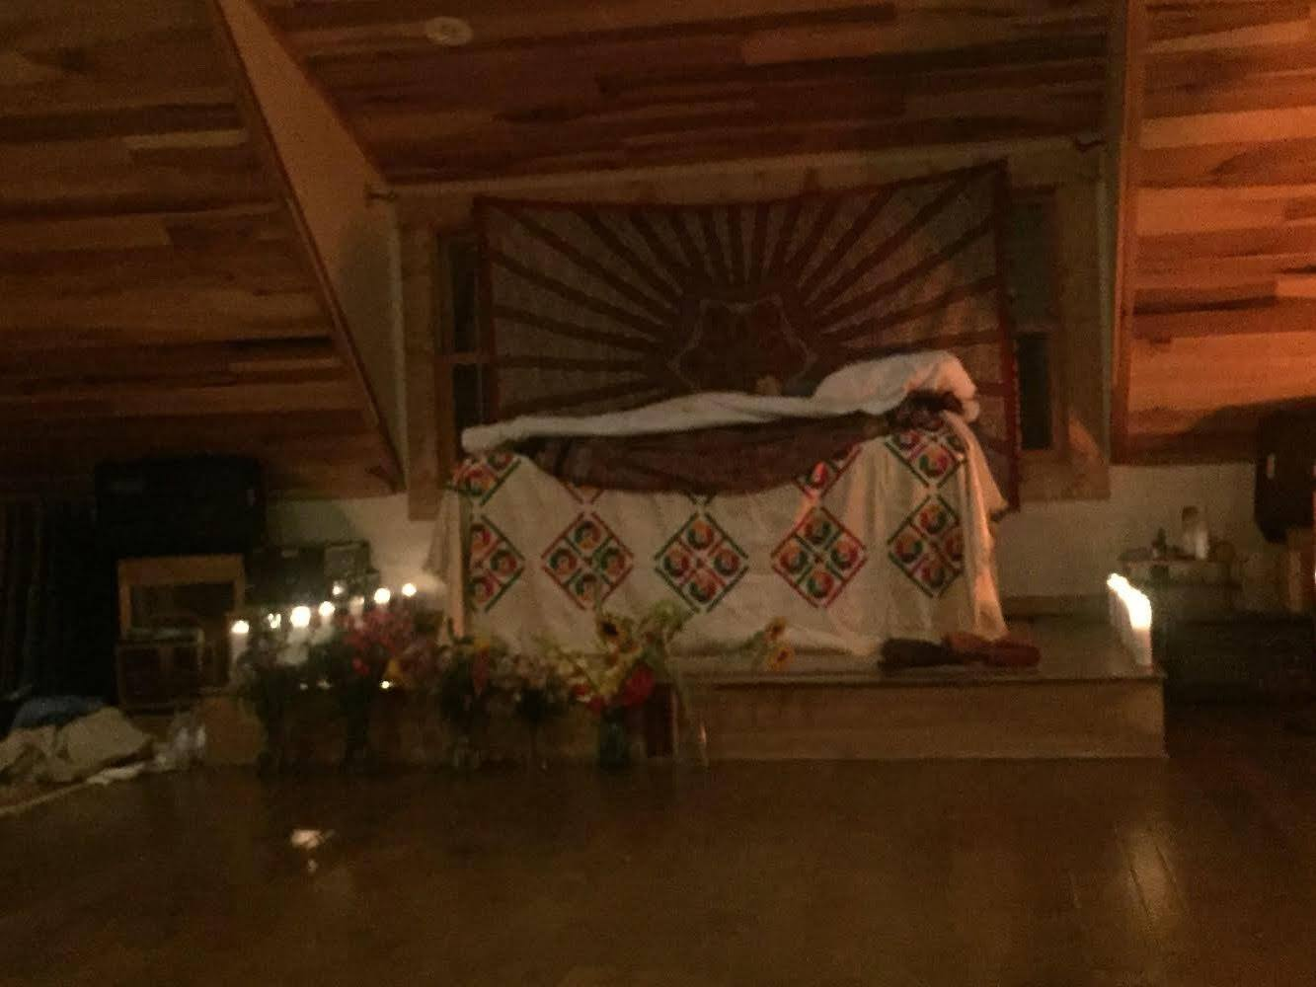

Slide 17
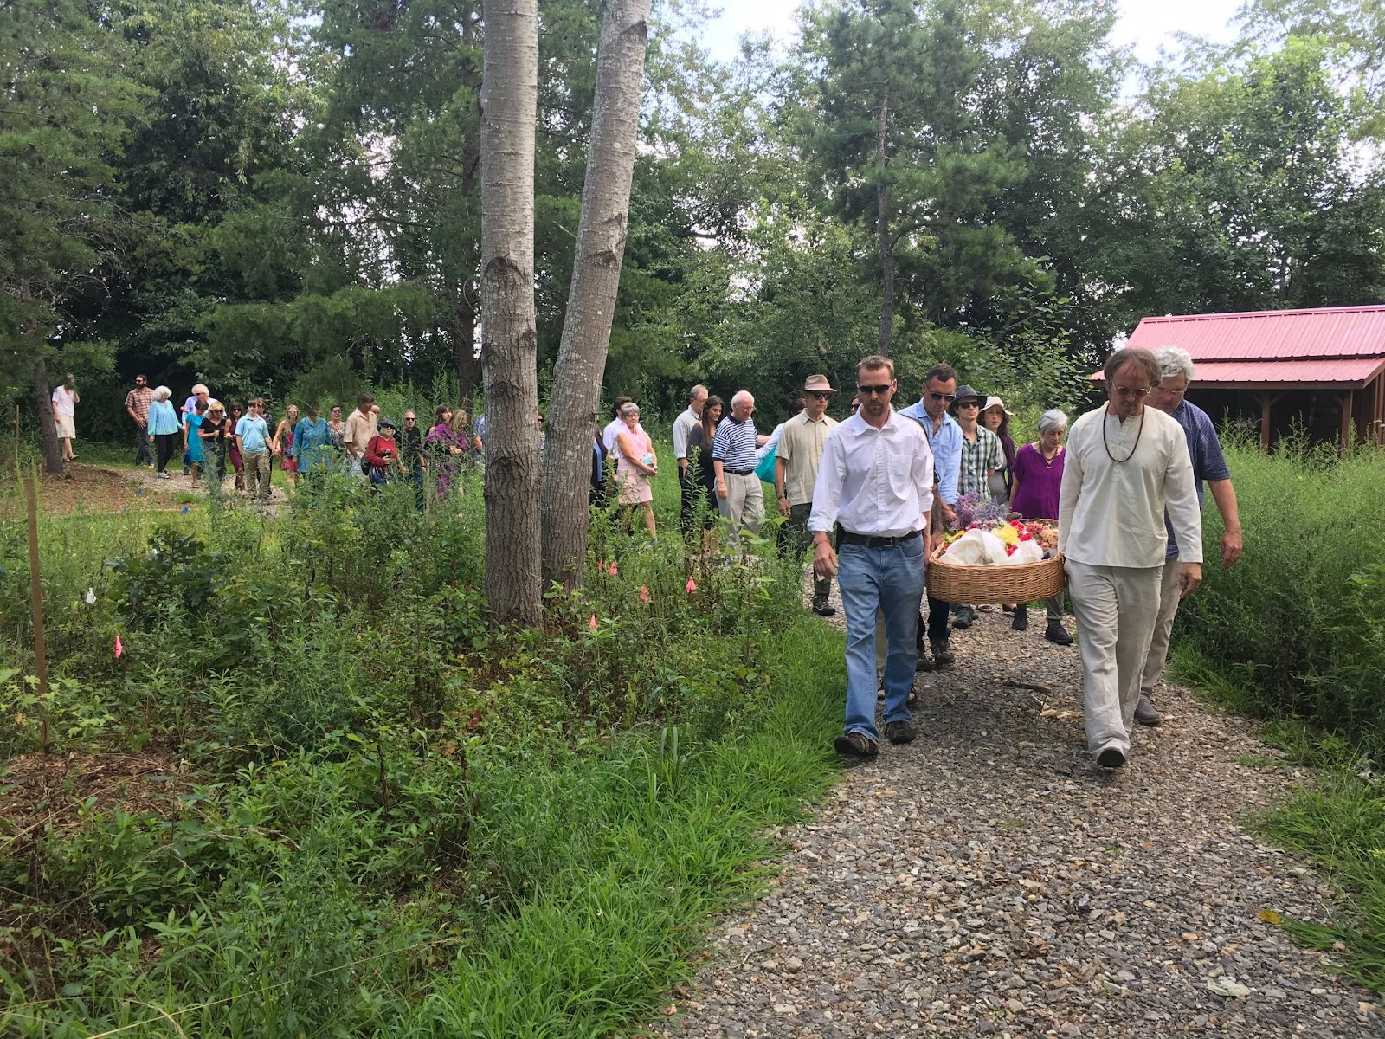

Slide 18
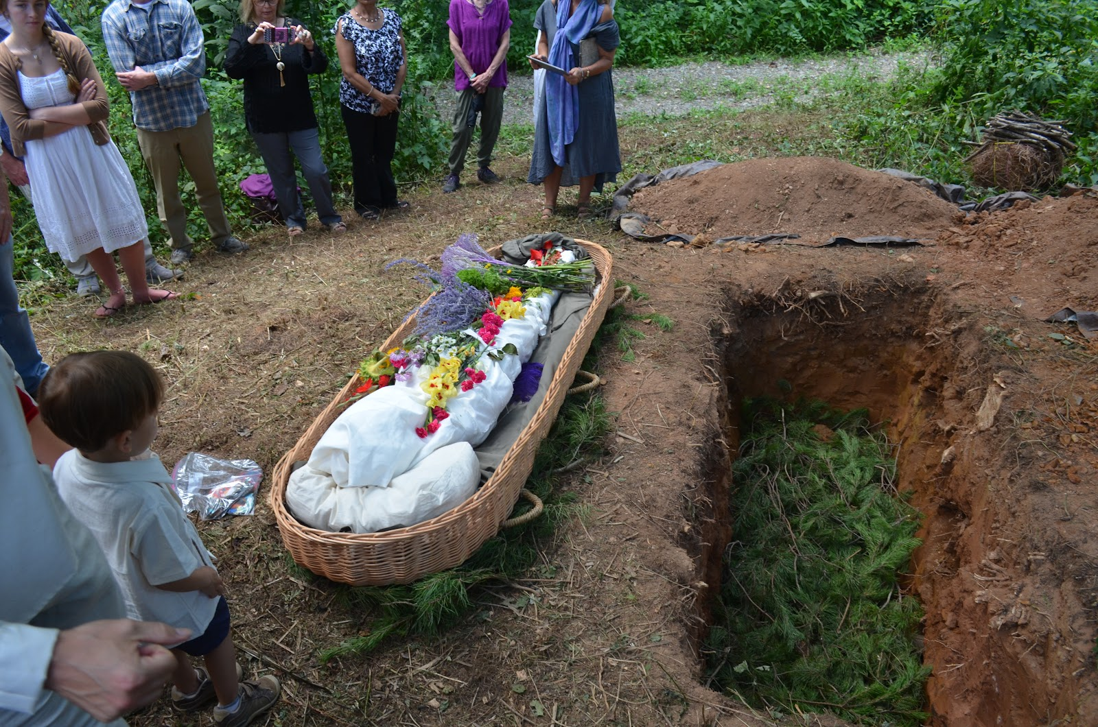

Slide 19
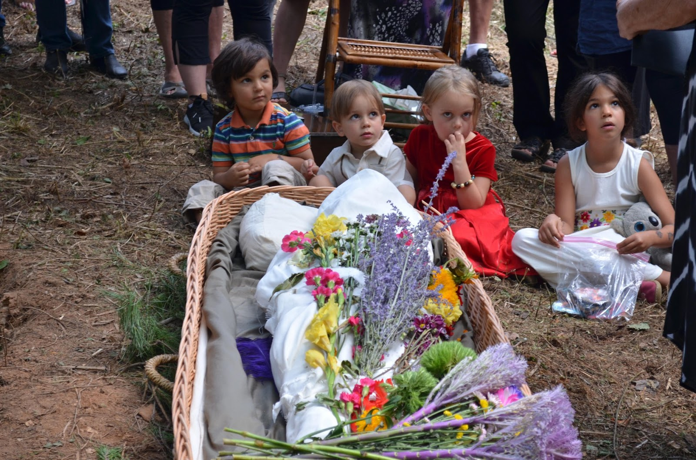

Slide 20


Slide 21
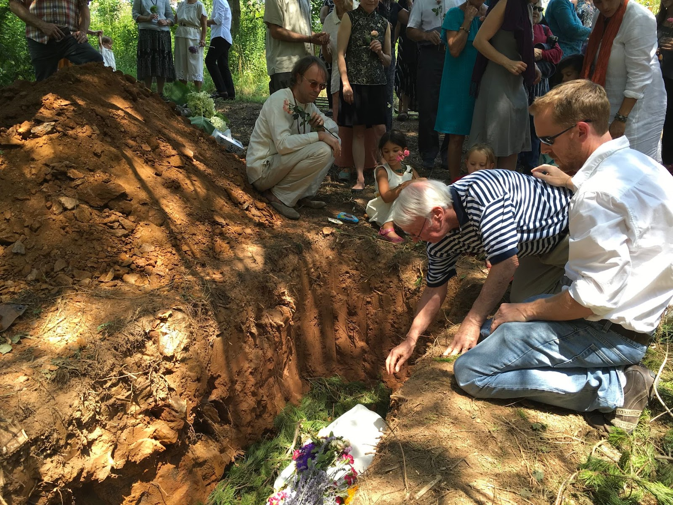

Slide 22
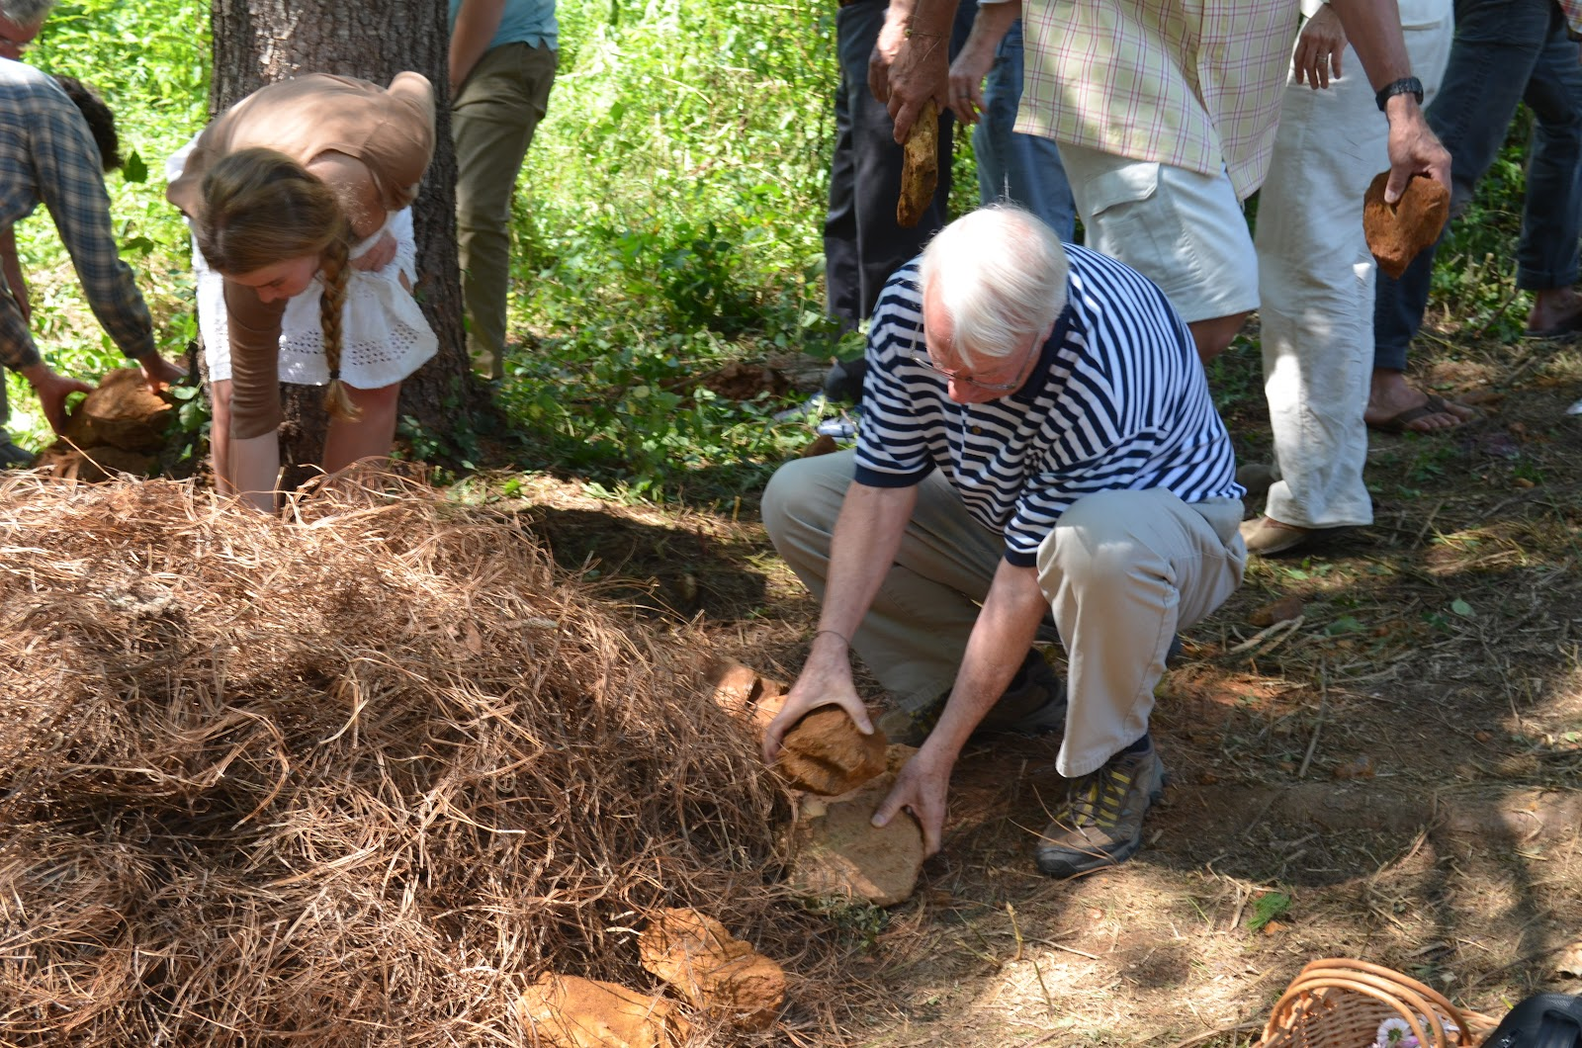

Slide 23
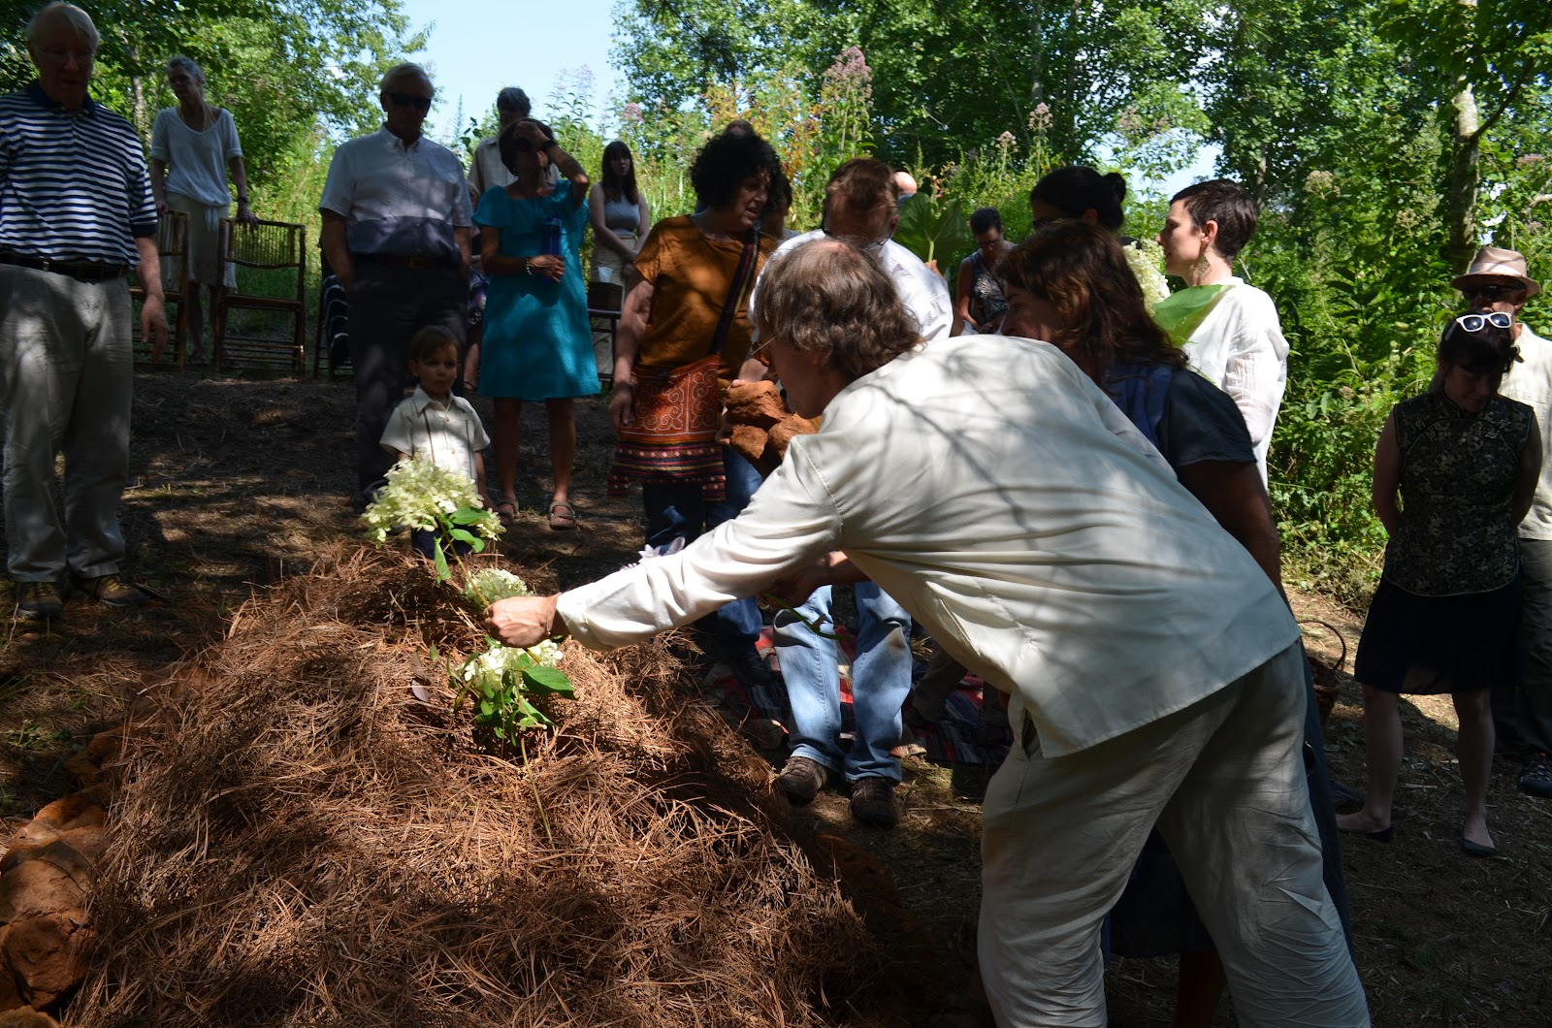

Slide 24
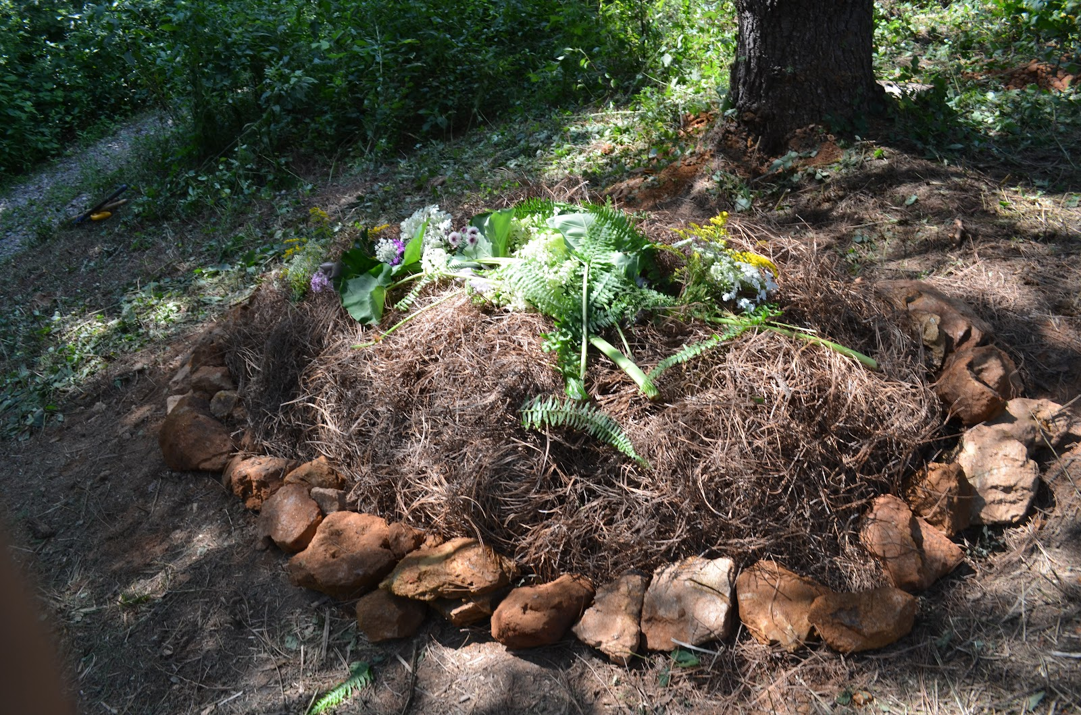

Slide 25
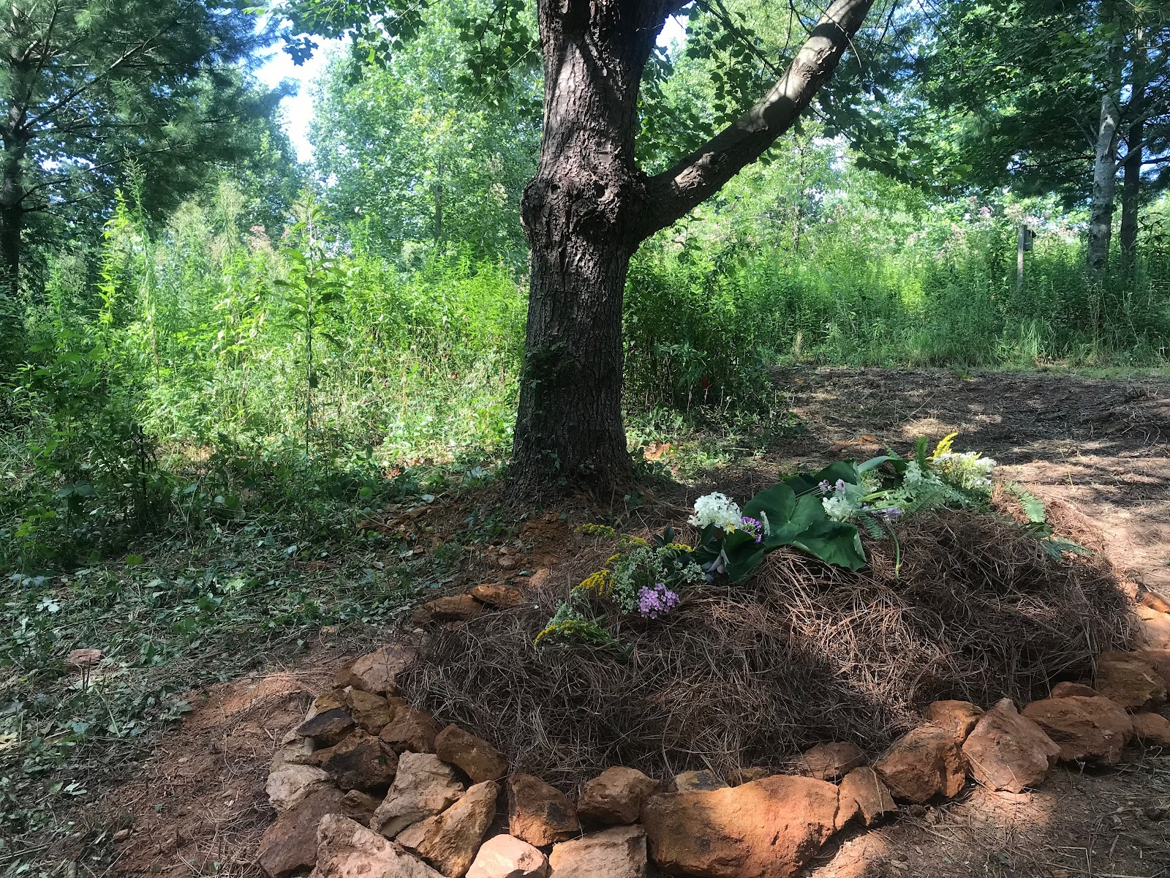

Slide 26
Death is not a medical event
With or without medical intervention, death is an inevitable part of life
Historically, death – like being born – was a family, communal and religious event, a natural part of life.
Death moved out of homes and into medical institutions by the 20th century
~70% people die in institutions -> though 70% of folks want to die at home
This final stage of life is distanced from the rest of living, few have a personal and direct experience with dying and death
We have autonomy – we have a say in when, where and how we will die

Slide 27
Hospice is not a place you go when you are ready to die .
Hospice is a philosophy of care and a system in place for delivering that care.
Majority of Hospice care occurs in homes or nursing facilities
Some communities have an inpatient hospice facility and those have certain criteria for admission

Slide 28
Hospice Definition
“Hospice”
Comes from the Latin root word hospitium
Referring to a place where guests were received with hospitality and lodging.
For terminally ill patients, prognosis of six months or less, and their families
Medical care for comfort, not curative treatments.
Involves an interdisciplinary team that provides the care, addressing spiritual, emotional and physical needs

Slide 29
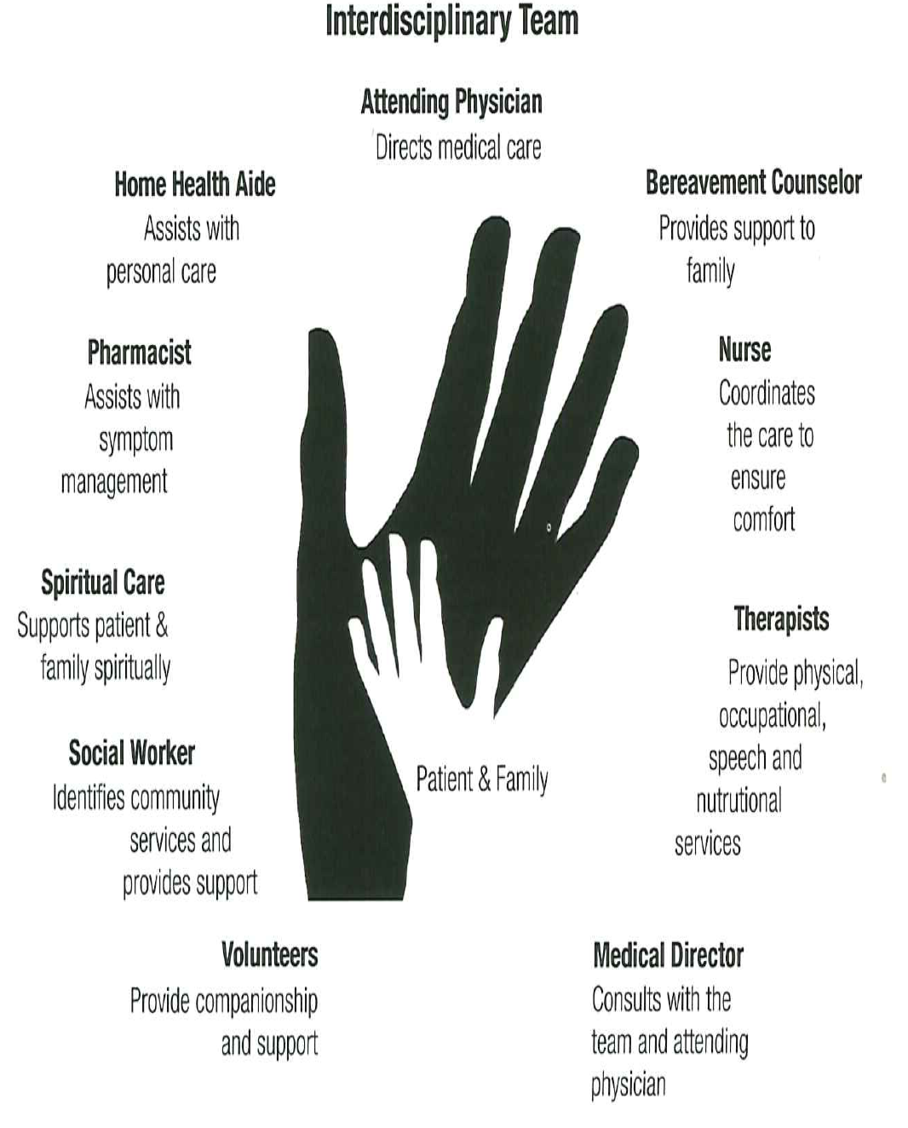

Slide 30
Hospice Care
Modern Hospice movement began in 1967 as a grassroots community hospice movement aimed at caring for cancer patients.
Traditional Model of Hospice Care
“Curative Care” | “Hospice”

Slide 31
Hospice and Palliative Care are not the same thing
There are distinguishing characteristics of each
“Palliative”
Comes from the Latin root word pallium
Referring to a garment that covered or cloaked a person or object.

Slide 32
Palliative Care
Whole person care
For individuals and families experiencing a debilitating chronic or life-threatening illness, condition or injury.
Applicable early in the course of illness
Can be used in conjunction with other therapies that are intended to prolong life.

Slide 33
Palliative Care
Expands the traditional medical goals of curing illness and prolonging life to:
emphasize the patient-centered goals
reduce symptom burden
enhance function
support hopes of patients with serious illness
assist with difficult medical decision making

Slide 34
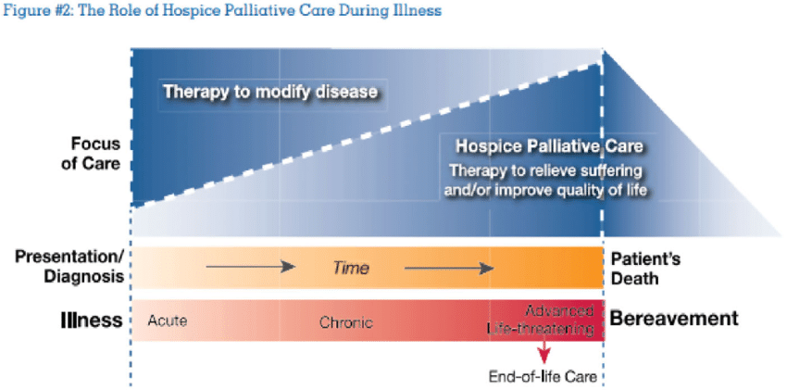
Current Model of Hospice and Palliative Care
Hospice is a place you go when you are imminently dying.
1

Slide 35
Curative vs Palliative Care Models
Curative
Palliative
Primary goal = Cure
Object of analysis = the disease
Symptoms are clues to diagnosis
Therapy aimed to eradicate or slow disease
Death is ultimate failure
Primary goal = Relief of Suffering
Object of analysis = individuals and family
Symptoms are entities in themselves
Therapy aimed to control symptoms and relieve suffering
Enabling person to live fully and comfortably until death is considered a success

Slide 36
Hospice does not provide 24/7 care for families
Hospice provides supportive services but majority of care rests on the family or individual’s support system.

Slide 37
Hospice Benefit
Hospice services are covered through Medicare or Medicaid hospice services, and by some private health insurance plans

Slide 38
Hospice Benefit includes:
Interdisciplinary Team Support
Medical equipment related to the terminal diagnosis
Necessary medical supplies
Medications to manage pain and control symptoms related to their terminal diagnosis.
Short-term in-patient care if needed to manage symptoms related to the patient’s terminal diagnosis.
Short-term respite care for up to 5 days
Follow-up for families for up to 13 months after a death occurs

Slide 39
NHPCO - 2016 Facts and Figures
In 2016, 48 percent of Medicare decedents were enrolled in hospice at the time of death.
40% of individuals utilized services for 14 days or less
98 percent of hospice care was provided at the Routine Home Care level.

Slide 40

Transition to Hospice Care
Does not mean you are shifting into “Reverse”
It does require a shift in thinking in a NEW direction…
Focus on Comfort
Focus on Individual/Family Goals
Focus on Quality of Life… not just Quantity
Ability to use tools in new/different ways
H

Slide 41
Transition from cure to comfort
Shift from curative focus on:
Therapeutic, disease modifying medications and treatments
To palliative focus on:
Palliative medications and comfort care

Slide 42
What Comfort Care is NOT
“Giving up”
“Losing hope”
“Stopping everything”
“Quitting”
“Losing the battle”
“Just letting someone die”
“Giving up hope”
“Doing nothing”

Slide 43
Turning the Corner
Why is it so difficult?
What are the obstacles for doctors, individuals and their families?
Misconception and Confusion
Negative perceptions
Discomfort communicating prognosis
Fear of losing control (primary MD can still follow)

Slide 44
The “D” Word…..
Every one of us will die, no matter what we do leading up to it.
Death is not the enemy.
Death is an integral part of life.

Slide 45
Timing Matters with Hospice Care
Timely Referral
Thoughtful, Integrated Plans
Ample emotional preparation
Arrangements in order
Connections to loved ones
Trusted, integrated care team
Peace, dignity, comfort, calm
A “Good Death”
Delayed Referral
Crises-driven response
Unresolved Personal Issues
Uncertainty and loose ends
Withdrawal and anxiety
Potentially fragmented care
Agitation, Confusion, Chaos
Fear and Unknowing

Slide 46
When to consider Hospice Care
Would you be surprised to hear that this person died?
What are their goals of care?
Advanced Directives
MOST form
Is this person clearly declining despite best efforts?
Progressive weight loss/eating difficulties
Increasing weakness/functional decline
Recurrent hospitalizations

Slide 47
Anticipated death always occurs quickly
Death is oftentimes a process, though can occur rapidly.
Majority of deaths occur after a period of illness with gradual deterioration

Slide 48
Statistics on Death and Dying in America CDC 2020
Number of deaths: 3, 464, 231
Death rate: 1043.8 deaths per 100,000 population
Life expectancy: 76.4 years
.

Slide 49
leading causes OF DEATH
Heart disease: 695,547
Cancer: 605,213
COVID-19: 416, 893
Accidents (unintentional injuries): 224, 935
Stroke (cerebrovascular diseases): 162, 890
Chronic lower respiratory diseases: 142, 342
Alzheimer’s disease: 119,399
Diabetes: 103,294
Chronic liver disease and cirrhosis: 56,585
Nephritis, nephrotic syndrome, and nephrosis: 54,358

Slide 50
Cancer Trajectory

Slide 51
Organ Failure Trajectory

Slide 52
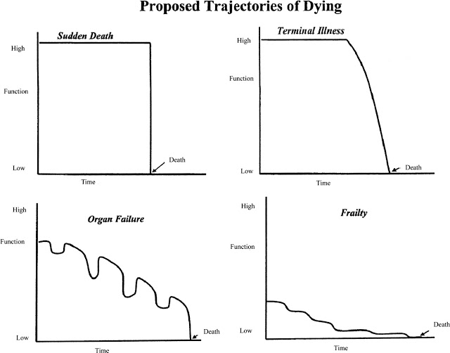

Slide 53
Death is NOT always miserable and painful
Natural death is not inherently painful.
At times pain can be severe, depending on the disease process
With good hospice and palliative care, symptoms are often well managed
Death often occurs by dehydration. People naturally stop eating and drinking in the dying process.
Many diseases lead to anorexia and cachexia, can be distressing to family members
Food and water are not withheld from someone who is dying

Slide 54
Role of medications in HPM
Medications play large role in management of pain and other physical ailments.
Common Symptoms at the End of Life:
Pain
Dyspnea
Nausea
Delirium
Secretions
Existential Distress
Psychedelics

Slide 55
Hospice does not ”kill” people with morphine
Using morphine to hasten death would be euthanasia which is illegal in the US.
Morphine titrated slowly for management of pain and shortness of breath has not been shown to hasten death.
Hospice does not kill people. It allows death to occur in its normal, natural time frame in a humane way.
There are other medications used in Hospice for symptom management.

Slide 56
Why would an individual want to hasten death?
Ready to die
Poor quality of life
Loss of independence
Loss of dignity
Continued existence viewed as pointless
Desire to control circumstances of death
Perception of self as burden to others
Inability to care for self

Slide 57
Why would an individual want to hasten death?
Extreme physical suffering
Fatigue
Inability to engage pleasurable activities
Pain
Loss of bowel and bladder function
Past experiences with death
Depression or other psychiatric disorder

Slide 58
Life-ending practices in the US
Withholding or Withdrawing potentially life sustaining therapy
(ventilator support, dialysis, insulin, artificial nutrition and hydration)
Physician-Assisted Death (PAD) or Aid-in-Dying (AID)
Voluntarily Stopping Eating and Drinking

Slide 59
Medical Aid-In-Dying
Practiced in 10 states + D.C:
California
Colorado
Hawaii
Maine
Montana
New Jersey
Oregon
Vermont
Washington
New Mexico
Washington, D.C

Slide 60
It is not always possible to predict the exact timing of death
It is a mystery as to when an individual will take their last breath.
There are some things that can guide us in making a prognosis
We generally talk in terms of minutes to hours, hours to days, days to week and weeks to months.

Slide 61
Physiologic Changes In the Dying Process
Early Stage
Bedbound
Loss of interest/ability to eat, drink
Cognitive changes: Increased sleepiness/delirium
Middle Stage
Further decline in mental status
Late Stage
Coma
Fever
Altered respiratory pattern
Mottled extremities, Cyanosis

Slide 62
Early Stage of Imminent Death
Fatigue and weakness
Decreased function, hygiene
Inability to move around in bed
Inability to lift head off pillow
Anorexia
Poor intake
Aspiration
Weight loss, muscle and fat, notable in temples
Decreased fluid intake
Dehydration, dry mucous membranes/conjunctiva
Cognitive changes
Increasing drowsiness
Day-Night reversal
Delayed responses, short sentences

Slide 63
Middle Stage of Imminent Death
Decreased level of consciousness
slow to arouse with stimulation
only brief periods of wakefulness
Terminal Delirium
Agitation, Restlessness
Purposeless, repetitous movements
Dysphagia
Coughing, choking
Loss of sphincter control
Incontinence of urine or bowels
Increased Secretions
Build up of oral and tracheal secretions
“Death Rattle”

Slide 64
Late Stage of Imminent Death
Respiratory Dysfunction
Abnormal breathing patterns
Cardiac Dysfunction
Elevated Heart Rate
Cooling of Extremities
Mottling of the skin
Renal Failure
Decreased urine output
Coma
Unresponsive to verbal or tactile stimuli

Slide 65
Talking about death does not result in death coming sooner
Talking about death openly creates opportunities for all involved and does not hasten death
Most people who are dying know they are dying.
Many individuals dying try to protect their loved ones from pain and anguish
Talking about death can bring a sense of peace and comfort to individuals if they are open to discussing their experience
Others have no interest in talking about death and find it stressful and anxiety provoking
Companion role is to meet individuals where they are on their terms.

Slide 66
Most people are not prepared for their final stages of life
Majority of people do not have advance directives in our country
Advance Directives include living wills and appointment of health care power of attorney
5 D’s (revisit every decade, when you encounter death, divorce, diagnosis of serious condition and decline)

Slide 67
Creating and End-of-Life Care Plan
A guide that identifies and outlines how you imagine being cared for at the end of your living days and beyond
A multifaceted endeavor that involves:
Advance Directives (Living Will and designation of HCPOA)
Estate Planning
Financial and Personal Matters
Vigil Planning
Legacy Work
After Death Care

Slide 68
When is it a good time to talk about death?
No amount of conversation and planning will cover everything you will encounter.
Still worthwhile to contemplate, explore and communicate your past, present and future beliefs and values.
I have had family members say “No one should ever have to make the decisions I had to make for my loved one,” – with no directives, no guidance, no clarity
Second guessing – some of this will occur anyway but some of this is avoidable

Slide 69
Eleven Tenets of Companioning the Bereaved
By Alan Wolfelt
Companioning is about being present to another person’s pain; it is not about taking away the pain.
Companioning is about going to the wilderness of the soul with another human being’ it is not about thinking you are responsible for finding the way out.
Companioning is about honoring the spirit; it is not about analyzing with the head.
Companioning is about listening with the heart - it is not about analyzing with the head.
Companioning is about bearing witness to the struggles of others; it is not about judging or directing these struggles.
Companioning is about walking alongside; it is not about leading.
Companioning is about discovering the gifts of sacred silence; it does not mean filling up every moment with words.
Companioning is about being still; it is not about frantic movement forward.
Companioning is about respecting disorder and confusion it is not about imposing order and logic.
Companioning is about learning from others; it is not about teaching them.
Companioning is about compassionate curiosity; it is not about expertise.

Slide 70
Carl Jung
“Joy at the smallest things comes to you only when you have accepted death. But if you look out greedily for all that you could still live, then nothing is great enough for your pleasure, and the smallest things that continue to surround you are no longer a joy. Therefore, I behold death, since he teaches me how to live (RB 275a).”

Slide 71

Center for Conscious Living & Dying

Slide 72
Ways to connect and offer support
Website: https://www.ccld.community/
Film: thelastecstaticdaysmovie.com
Sign up for CCLD updates & news: https://www.ccld.community/subscribe
Please make a donation to support this work: https://www.ccld.community/donation

